Slide 1
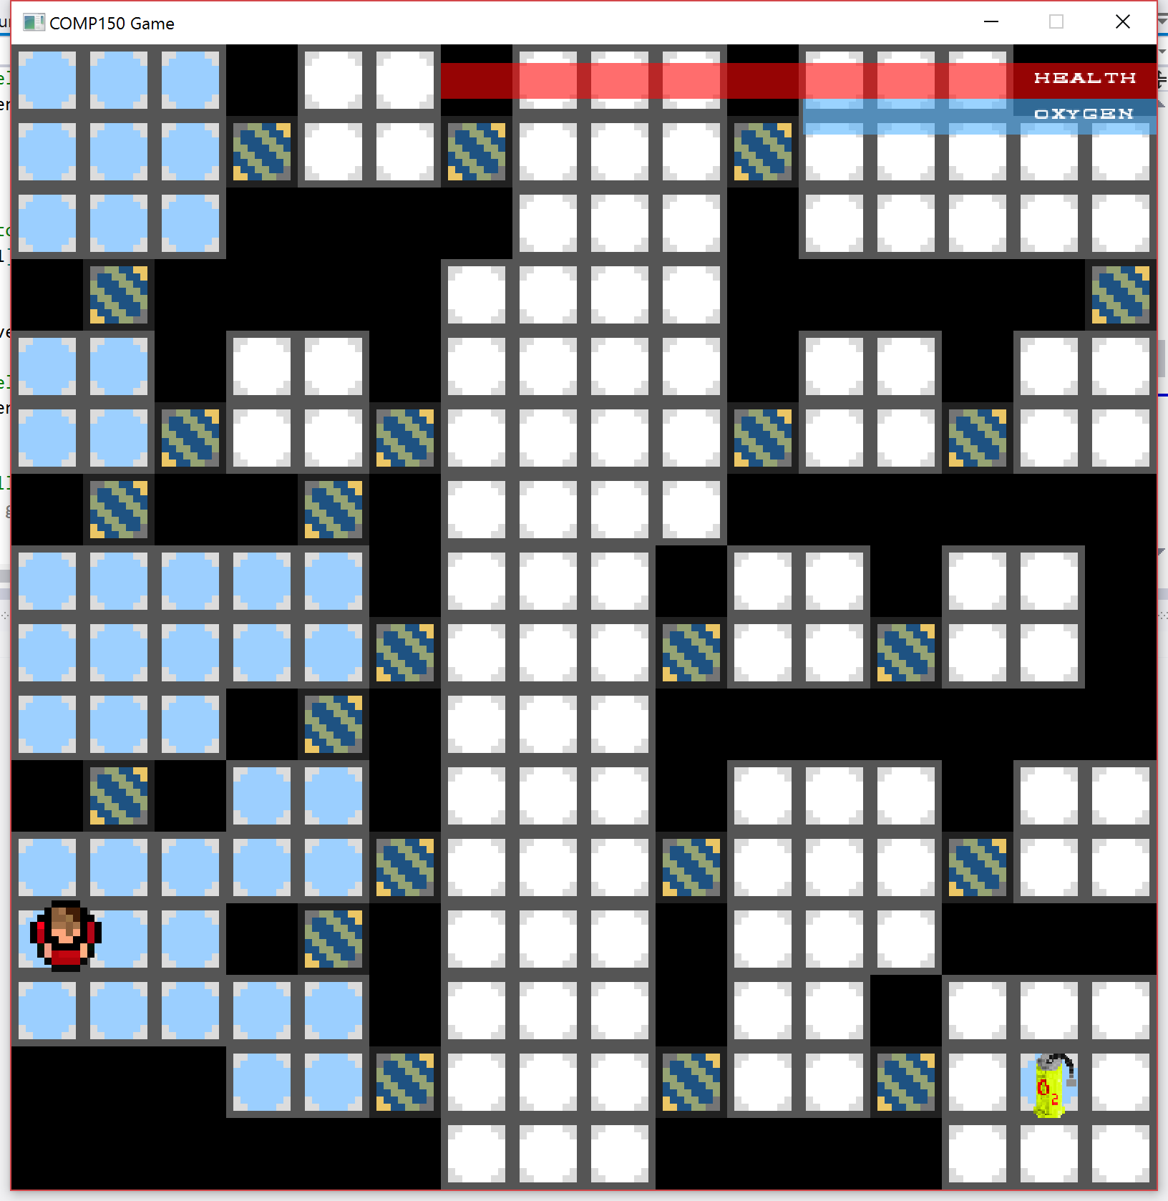
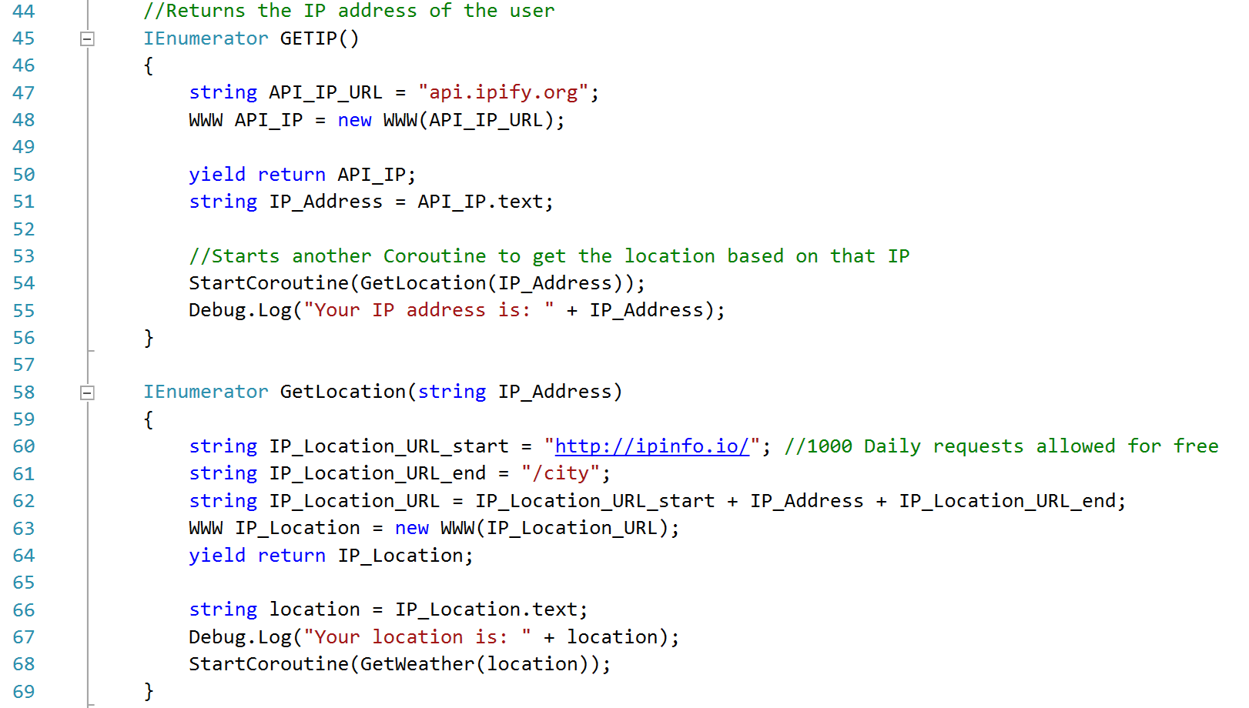
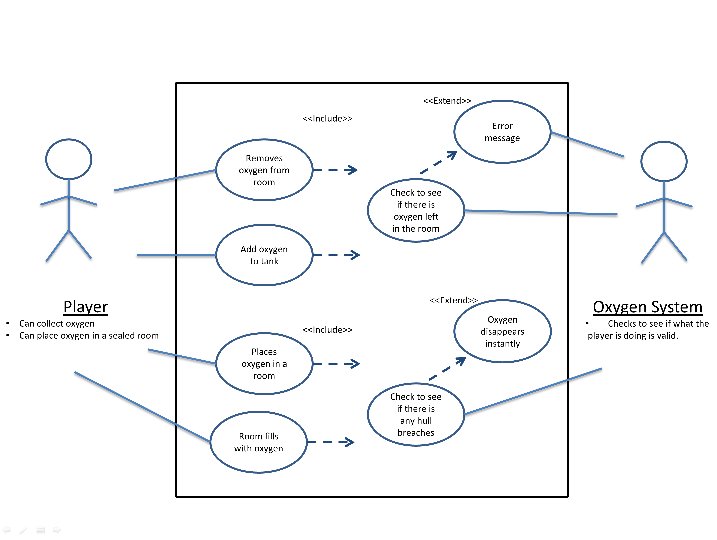
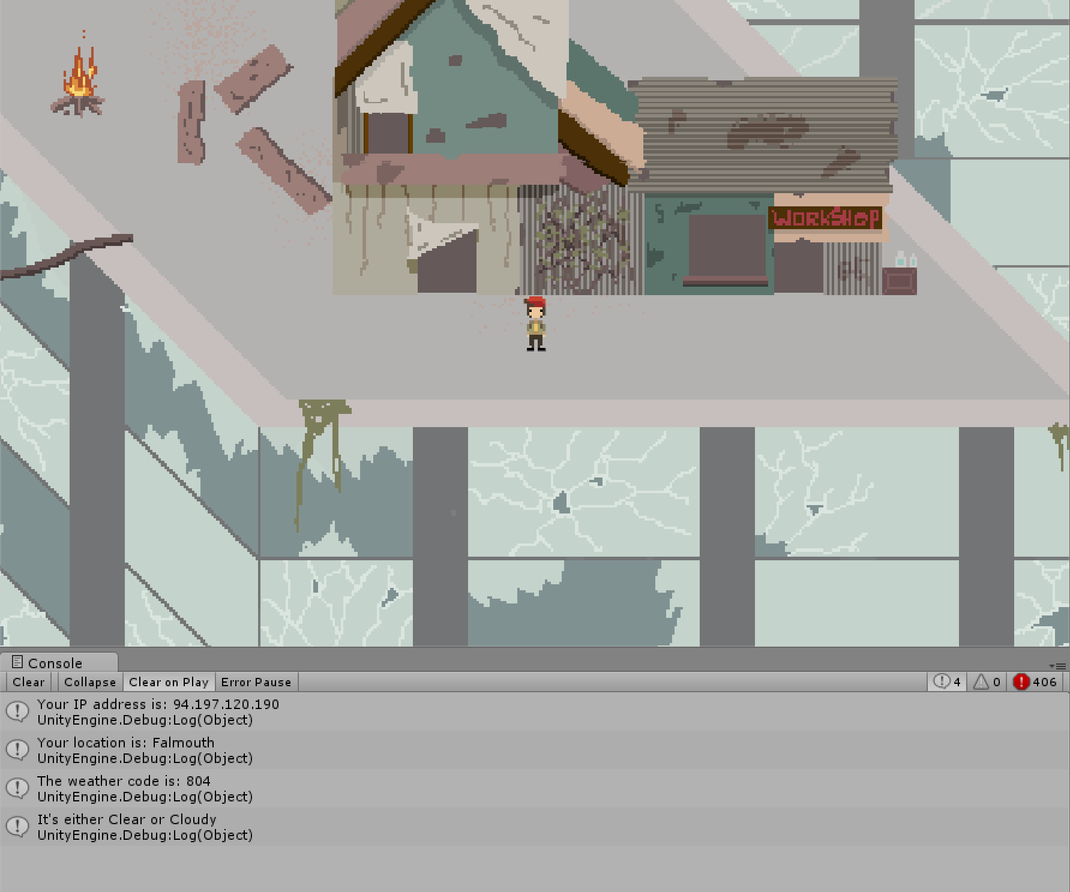
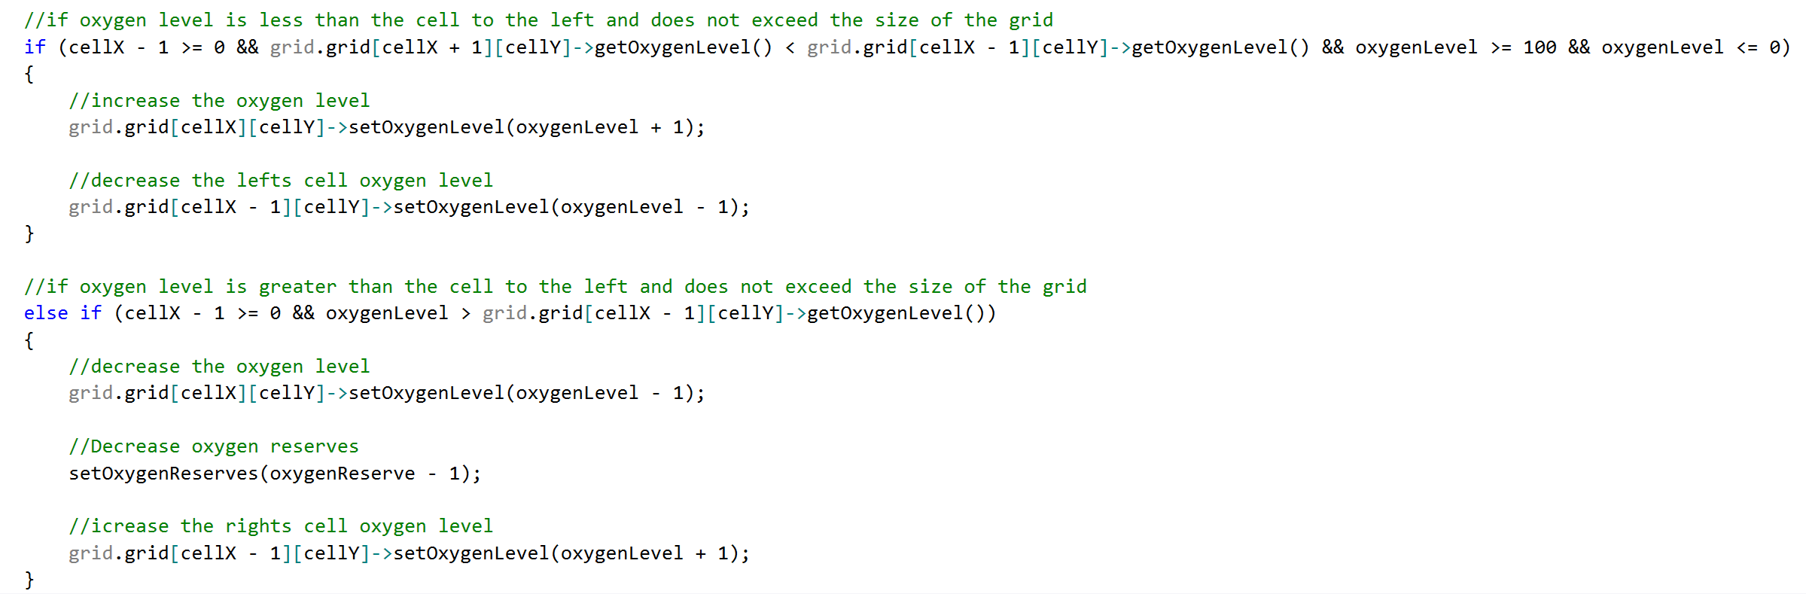
Coding Task II & Weather API
Oxygen Coding Task II
Weather API
For the comp150 game I focused on the oxygen mechanic, this involved adding oxygen to cells in the game, and then that oxygen will spread to neighbouring cells and then that would fill a room with oxygen.
This weather API will check the players location based on their IP address and then use a weather API to set the weather to the players current weather at their location.
This is the code that checks the IP address and location of the player.
This is the final game, with oxygen placed in some of the rooms.
This weather API integrated three separate APIs together. First it checked the users external IP address with:
http://api.ipify.org/
Then the script got the location of the user with:
http://ipinfo.io/
Then it gets the weather with:
http://openweathermap.org/
Use Case Diagram of how the oxygen system works.
Sample bit of code that checks the neighbouring cells oxygen value
An Image of the code working in game and setting the weather to clear

